Slide 1
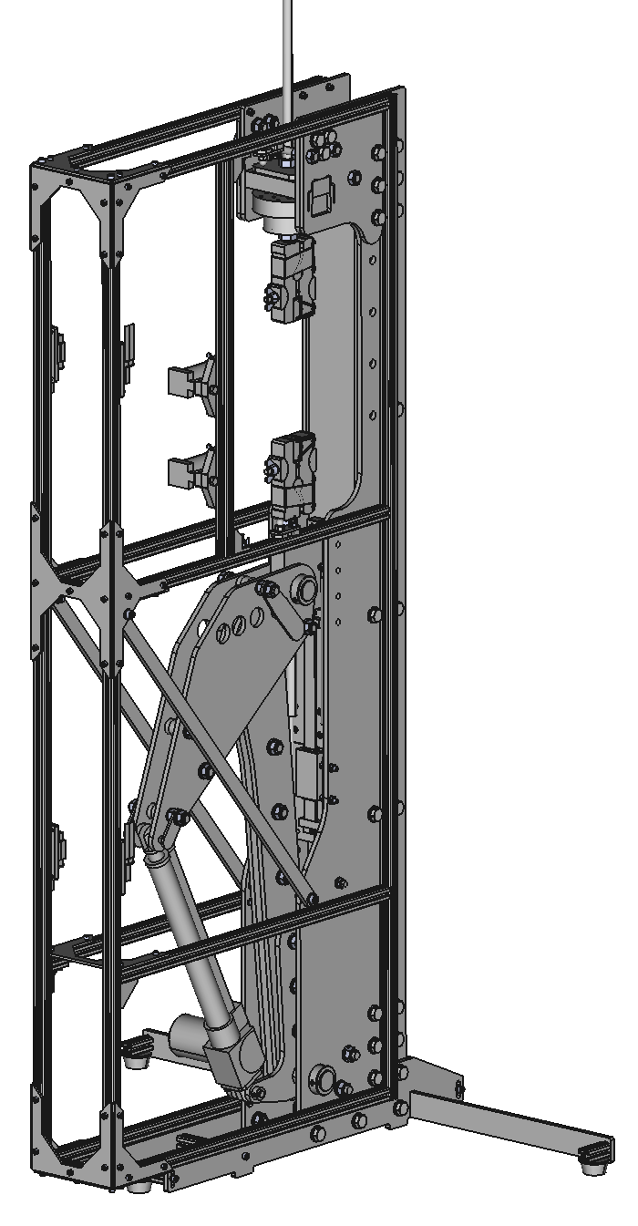
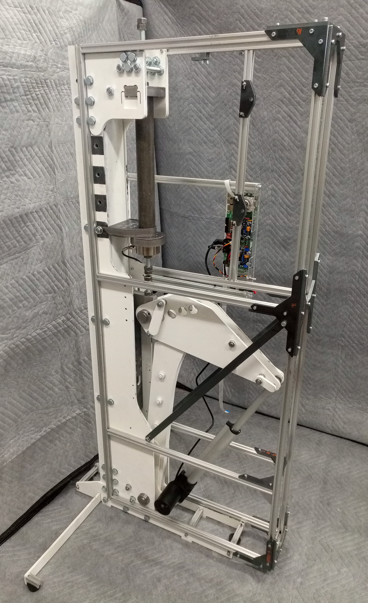
Interchangeable/offsettable standardised thread load cell and grip system
Instrument fully enclosed by frame for optional interlocked doors/accessory attachment
Native mounting provision for Raspberry Pi cameras and LED light sources for optical extensiometry
Appreciable space for sample/grips/load cell
~1.6m
Substantially built instrument superstructure (steel box tube core, steel side panels)
Lever with interchangeable ranges (via movable pin)
Digital scale provision for non-optical extensiometry tests
Linear DC actuator
Removable instrument feet for horizontal operation
(Early prototype assembly photo)

Slide 2
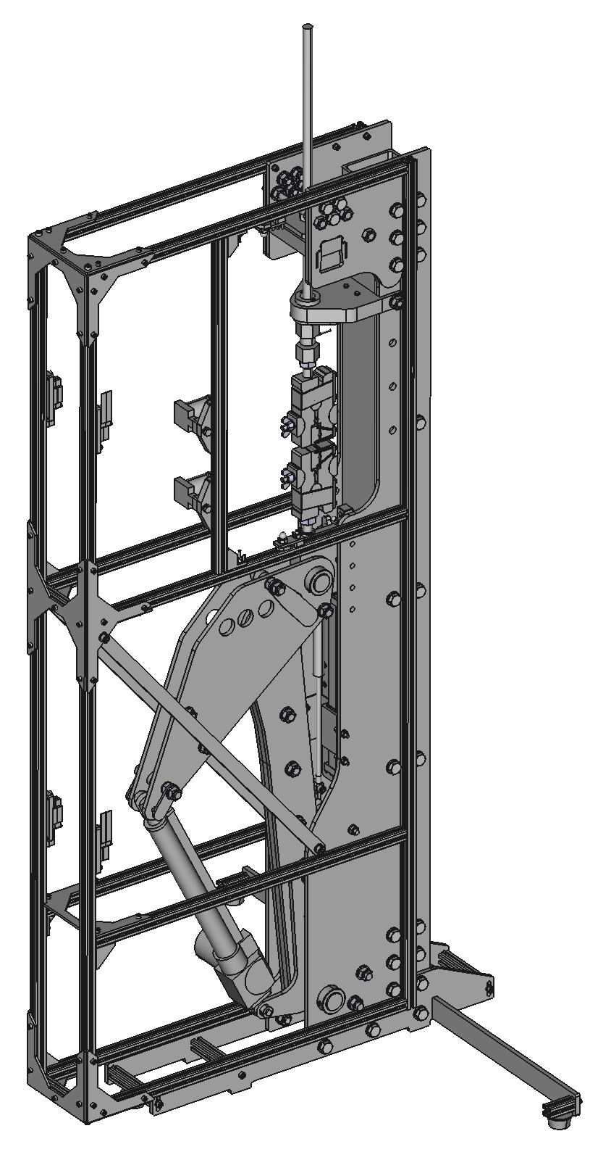
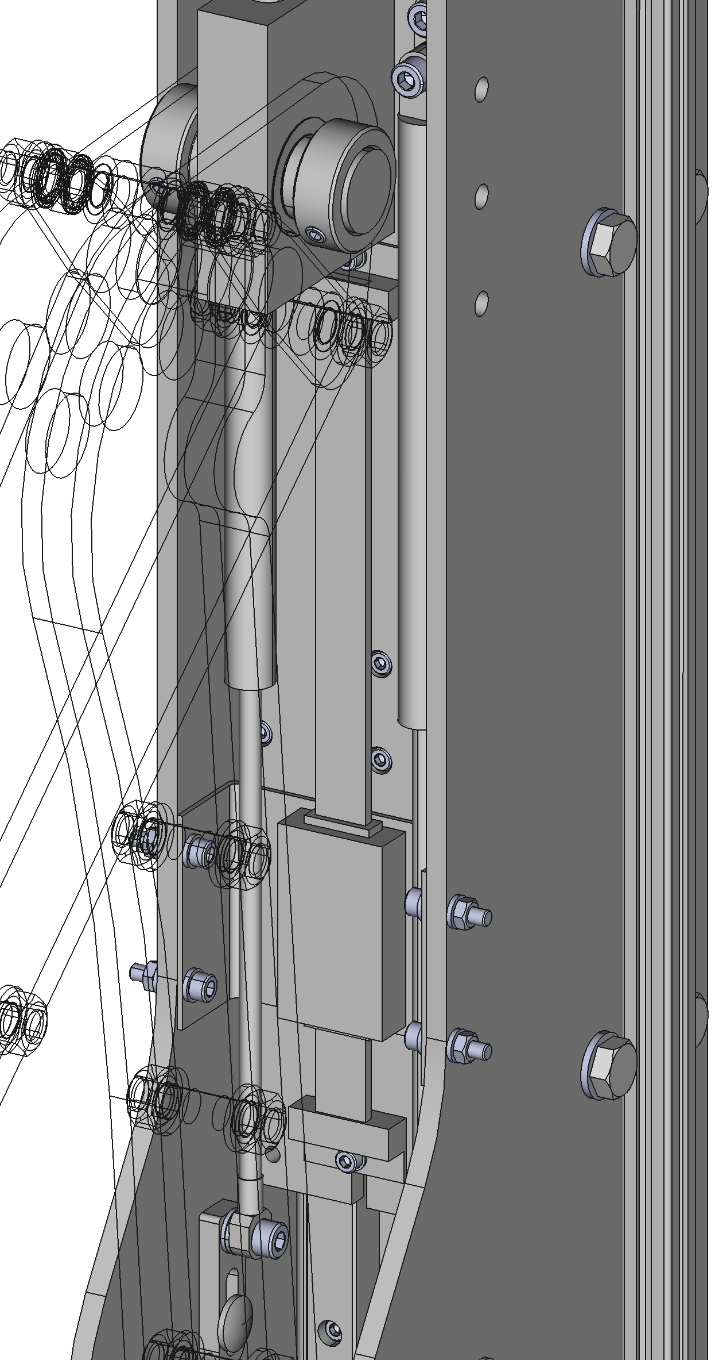
(22)
(14)
(24)
(17)
(6)
(23)
(21)
(9)
(25)
(7) Sample section
(1)
(14)
(17)
(15)
(8) Actuator section
(20)
(13)
(20)
(18)
(12)
(11)
(2)
(18)
(3)
(5)
(4)
(13)
(10)
(19)
(16)
(2)
(3)

